Slide 1
Research Communication Skills
Writing Research Papers

Slide 2
Intended Learning Outcomes
By the end of this lesson you will be able to:
  determine when to start writing the paper
  express the information in the paper in diverse ways (text, figure, table)
  compose a research paper

Slide 3
What do researchers do?
Your answer from last class
  Read
  Think
  Write
  ….
When do they write in relation to reading and thinking?
Do they write after all the thinking is done or before?

Slide 4
Writing papers: two models
Idea
Do research
Write paper
Idea
Write paper
Do research

Slide 5

Writing papers: two models
Idea
Do research
Write paper
Idea
Write paper
Do research
Forces us to be clear, focused
Crystallises what we don’t understand
Opens the way to dialogue with others: reality check, critique, and collaboration

Slide 6
The scope of your paper
Your paper should have just one clear idea
You may not know exactly what the idea is when you start writing; but you must know when you finish
If you have more ideas, write more papers

Slide 7
Writing process tips
Start early, quickly write your first draft (not a draft, but any draft). Don't be afraid to think before you write, or even jot down notes, diagrams, and so on
Write in brief daily sessions
Use index cards. Use them to plan a draft or to organize or reorganize a large unit like a section or chapter
Don't worry about page limits. Write the paper you want, then cut it down to size
Cut. Plan a revision session in which your only goal is to cut.

Slide 8
Why write papers?

Slide 9
Paper writing is teaching
It is useful to think that you are teaching your reader your idea
  What you did
  Why it’s important
  How it works
Well-written papers contribute more than just their described results
  Readers understand the topic better

Slide 10
Your narrative flow
Here is a problem
It’s an interesting problem
It’s an unsolved problem
Here is my idea
My idea works (details, data)
Here’s how my idea compares to other people’s approaches

Slide 11
Typical paper structure in computing science
Title (~1000 readers)
Abstract (~100 readers)
Introduction (~100 readers)
Related work* (~10 readers)
Proposed design/system/method (~3 readers)
Evaluation
Discussion
Related work*
Conclusions & Future work
References

Slide 12
Typical paper structure in computing science
Abstract
Introduction
Related work*
Proposed design/system/method
Evaluation
Discussion
Related work*
Conclusions & Future work
References
Content:
  Very short (~250 words)
  Brief description of purpose
  Highlight main results
Purpose:
  “Hook” the reader
    Why is this paper interesting?
    Why should I spend my time reading this?
    What do you claim to do?
  Set the stage for the paper

Slide 13
Typical paper structure in computing science
Abstract
Introduction
Related work*
Proposed design/system/method
Evaluation
Discussion
Related work*
Conclusions & Future work
References
Content:
  Usually 1-1.5 pages
  Main elements
    What is the problem?
    Why is the state of the art insufficient?
    Overview of the solution
    Novel contributions of the work?
    How is impact evaluated?
  Balance content and conciseness!
Purpose:
  Motivate the work
  Inform the reader of what is to come
  Many reviewers will make their initial decisions after reading only the intro!

Slide 14
The introduction (1 page)
Describe the problem
  What is the broader context?
  What is the particular problem?
  - Why is it interesting?
State your contributions
  What is new? (novelty)
  Why is it useful? (features of your solution)
  How do you know? (evaluation)
Assume reader is general attendee of target conference

Slide 15
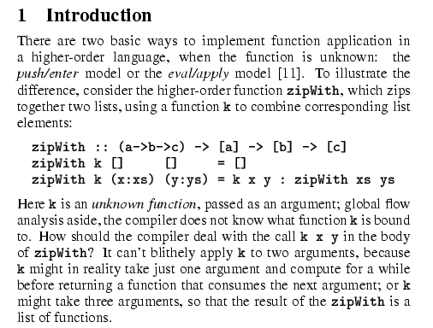
Describe the problem
Use an example to introduce the problem

Slide 16
State your contributions
Write the list of contributions first
The list of contributions drives the entire paper: the paper substantiates the claims you have made

Slide 17
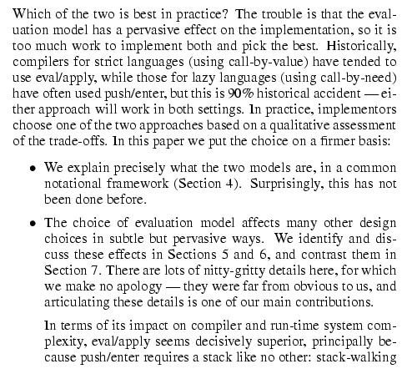
State your contributions
Bulleted list of contributions
Do not leave the reader to guess what your contributions are!

Slide 18
Lengthening the introduction
The introduction can be viewed a capsule of the entire paper
  The context, the problem, your idea, and its evaluation
You could shorten or avoid the problem and idea sections and have a longer intro
  E.g., they are subsections of the intro
  But beware of taking too long to get to the point; reader will get frustrated

Slide 19
Typical paper structure in computing science
Abstract
Introduction
Related work*
Proposed design/system/method
Evaluation
Discussion
Related work*
Conclusions & Future work
References
Content:
  Overview of past research/results
  Comparison to claimed contributions
  Not a book report!
Purpose:
  Motivate the work (How?)
  Inform the reader that you are aware of prior results
  Clearly demonstrate the novelty in your approach
Note: Related work may occur at the beginning or end of a paper
- Beginning: Prior work is necessary for understanding this paper
- End: Prior work is only tangentially related

Slide 20
Typical paper structure in computing science
Abstract
Introduction
Related work*
Proposed design/system/method
Evaluation
Discussion
Related work*
Conclusions & Future work
References
Content:
  Maybe more than one section…
    Requirements, Design
    Syntax, Semantics, Enforcement
    Design, Implementation
    …
  This is the novel content of a paper
Purpose:
  Proposal of original idea(s)
  This is the authors’ contribution!
  Should be detailed enough for others to replicate the work (in theory)

Slide 21
Presenting the idea
3. The idea
Consider a bifircuated semi-lattice D, over a hyper-modulated signature S. Suppose p_{i} is an element of D. Then we know for every such p_{i} there is an epi-modulus j, such that p_{j} < p_{i}.
Sounds impressive...but
Sends readers to sleep
In a paper you MUST provide the details,
but FIRST convey the idea

Slide 22
Presenting the idea
Explain it as if you were speaking to someone using a whiteboard
Conveying the intuition is primary, not secondary
Once your readers have the intuition, they can follow the details (but not vice versa)
Even if they skips the details, she still takes away something valuable

Slide 23
Typical paper structure in computing science
Abstract
Introduction
Related work*
Proposed design/system/method
Evaluation
Discussion
Related work*
Conclusions & Future work
References
Content:
  Could be any number of things
    Performance measurements
    Simulation results
    Analysis of user study data
    Formal proofs
    …
Purpose: “Prove” that the stated contributions are meaningful

Slide 24
The details: evidence
Your introduction makes claims
The body of the paper provides evidence to support each claim
Check each claim in the introduction, identify the evidence, and forward-reference it from the claim
Evidence can be: analysis and comparison, theorems, measurements, case studies

Slide 25
Typical paper structure in computing science
Abstract
Introduction
Related work*
Proposed design/system/method
Evaluation
Discussion
Related work*
Conclusions & Future work
References
Content:
  Not all papers have this
  If included, typically contains
    An interpretation of results/evaluation
    Discussion of open problems Description of limitations
Purpose:
  Papers do not often “close” a topic
  This is where you reflect on what has been done, and what is still open

Slide 26
Typical paper structure in computing science
Abstract
Introduction
Related work*
Proposed design/system/method
Evaluation
Discussion
Related work*
Conclusions & Future work
References
Content:
  Far too often: Rehash of the paper (this is not an abstract!)
  Ideally: Reflection on contributions
Purpose:
  One last summary of contributions given the whole context of the work
  Identification of promising future research directions

Slide 27
Paper Writing Tips

Slide 28
The Body of a Section
What happens here
How this fits (optional)
The results
Transition
In this section …
This section continues the derivation by …
Thus far, the discussion has … Here, …

Slide 29
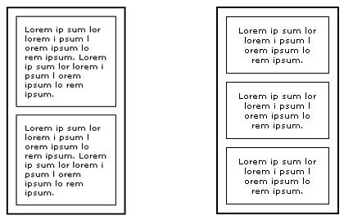
Paragraph

Slide 30
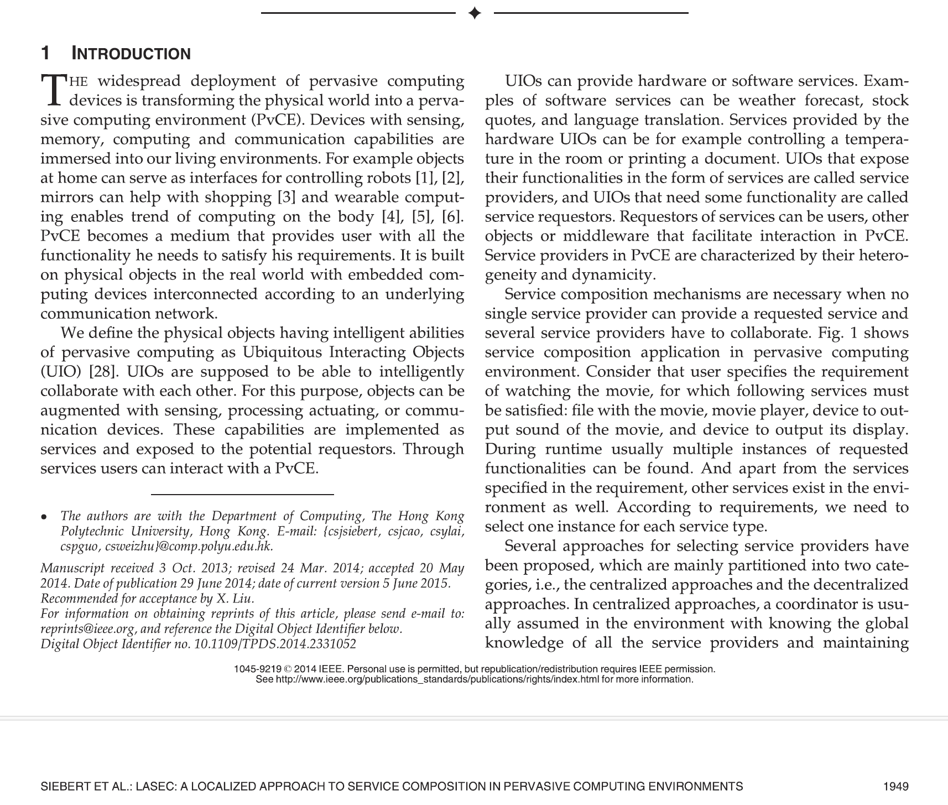
Paragraph

Slide 31
Paragraph

Slide 32
Paragraph
A paragraph is a collection of related sentences dealing with a single topic.
Learning to write good paragraphs will help you as a writer stay on track during your drafting and revision stages.
Good paragraphing also greatly assists your readers in following a piece of writing.
You can have fantastic ideas, but if those ideas aren't presented in an organized fashion, you will lose your readers (and fail to achieve your goals in writing).

Slide 33
Paragraphing
The basic rule of thumb with paragraphing is to keep one idea to one paragraph.
If you begin to transition into a new idea, it belongs in a new paragraph.

Slide 34
Paragraphing
Put only one main idea per paragraph.
Aim for three to five or more sentences per paragraph.
Include on each page about two handwritten or three typed paragraphs.
Make your paragraphs proportional to your paper. Since paragraphs do less work in short papers, have short paragraphs for short papers and longer paragraphs for longer papers.
If you have a few very short paragraphs, think about whether they are really parts of a larger paragraph—and can be combined—or whether you can add details to support each point and thus make each into a more fully developed paragraph.

Slide 35
Paragraphing
Ways to tell if you are on the same topic or a new one.
  The same topic
    You can have one idea and several bits of supporting evidence within a single paragraph.
    You can also have several points in a single paragraph as long as they relate to the overall topic of the paragraph.
  New topic
    If the single points start to get long, then perhaps elaborating on each of them and placing them in their own paragraphs is the route to go.

Slide 36
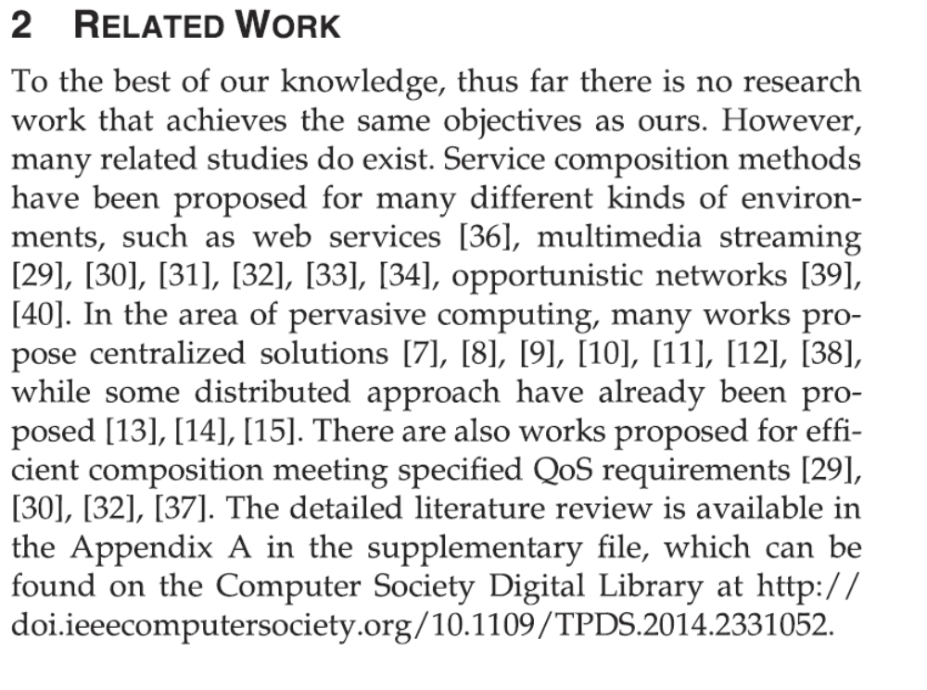
Example
Several points in a single paragraph – all the points relate to the overall topic of the paragraph: description of studies related to the work described in this paper

Slide 37
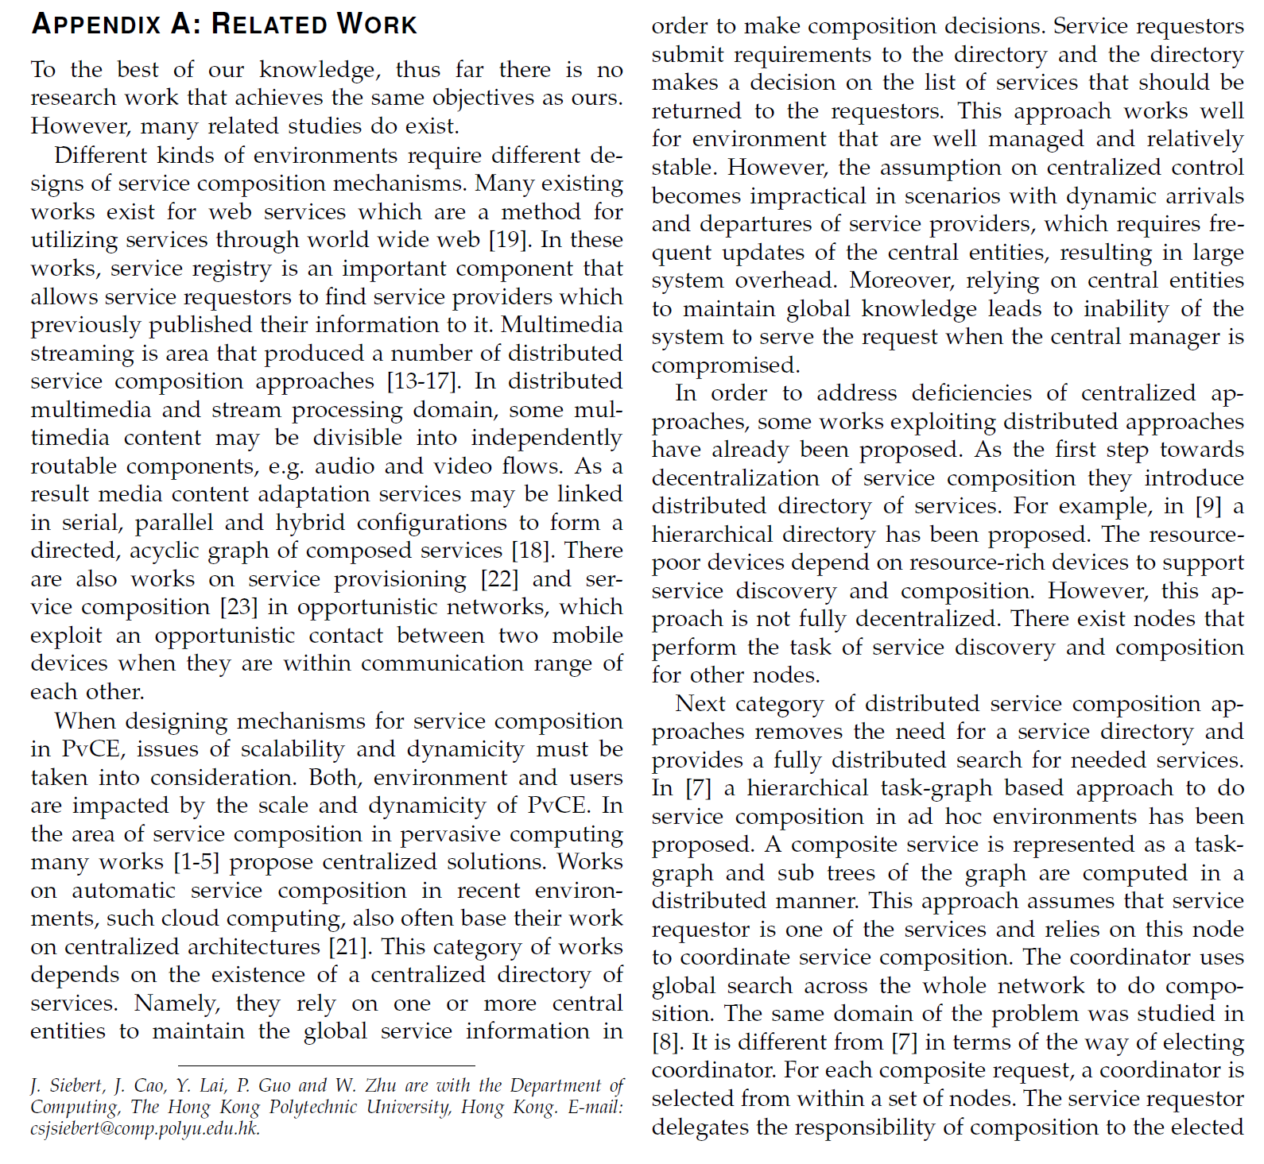
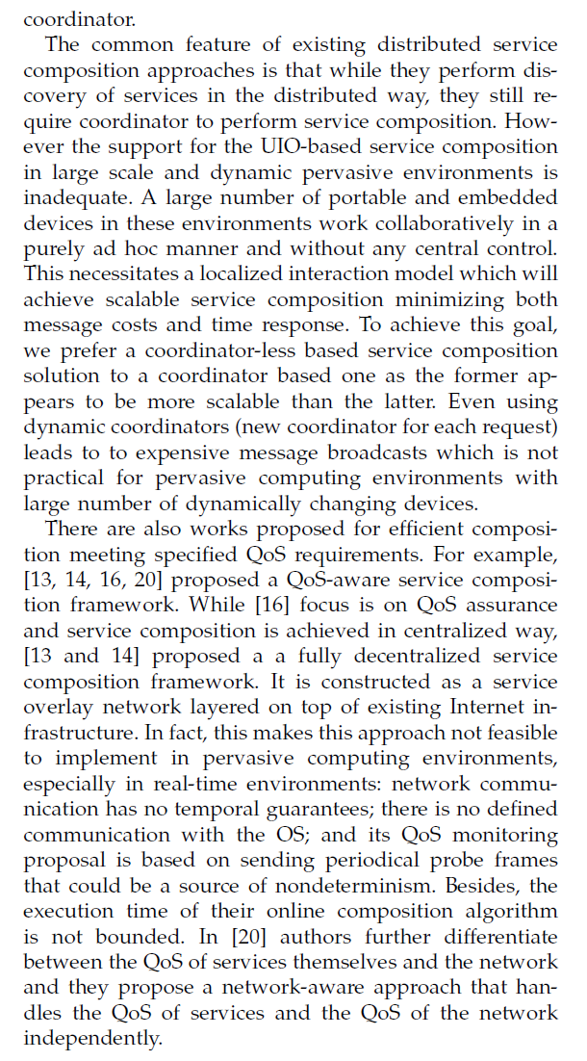

Slide 38
Example
The points in the paragraph have been elaborated on and placed in their own paragraphs

Slide 40
Paragraphs
Each paragraph must be:
  Unified: all the sentences relate to one central point or idea.
  Coherent: the sentences are logically organized and clearly connected.
  Relevant: the paragraph supports the overall theme and purpose of the paper.

Slide 41
Structure of a basic paragraph
Topic Sentence (TS) - the beginning
  Needs to state ONE idea clearly
  Useful Tip: Always put the most important information first!
Supporting Sentences (SS) - the middle
  Elaborates and explains the idea introduced in the topic sentence
  Provides evidence and examples
  Explains the evidence or example included - why is it relevant?
Concluding Sentence (CS) - the end
  Makes links: back to the main idea of the paragraph; back to research question or topic of the assignment; to the next paragraph

Slide 42
Exercise 1

Slide 43
Paragraph example
Children can also be influenced negatively as a result of media. Over exposure to television and gaming are two examples of possible negative impacts on children. Research suggests that children who are over-exposed to television are more likely to display aggressive behaviours than those who are not. For example, a ten-year longitudinal study of over 430 children revealed that eight-year-old boys “who were in the upper 20% of television exposure were significantly higher on measures of aggression than the study’s other participants” (Eron, Huesmann, Lefkowitz and Walder 1972, cited in Sullivan 2013, p.46). The study also found that these children continued to show aggressive behaviour throughout their childhood and teens (Eron, Huesmann, Lefkowitz and Walder 1972, cited in Sullivan 2013). Furthermore, these children, who were studied into their twenties and thirties, continued to show high measures of aggression (Huesmann, Moise-Titus, Podolski & Eron 2003, cited in Sullivan 2013). This suggests that over exposure to television can have long term and negative impacts on the behaviour of children. These effects not only impact aggressive behaviour, but also children’s attitudes and values (Clay, 2003). Additional research on the link between exposure to video gaming and aggression is suggesting similar findings with a link between time spent on video games and higher scores on measures of aggression (Anderson and Bushman 2001 cited in Kirsh 2003). They suggest gaming influences aggressive behaviour, cognition, and physiological arousal. Given that 80 percent of the most popular video games on the market today are violent in nature (Diez 1998, cited in Kirsh 2003), the influence of gaming on levels of aggression are concerning. Media, then, can have a negative impact on levels of aggression on children who are over-exposed to television and video games.

Slide 44
Paragraph example
Topic Sentence
Supporting Sentences
Concluding Sentence
Children can also be influenced negatively as a result of media. Over exposure to television and gaming are two examples of possible negative impacts on children. Research suggests that children who are over-exposed to television are more likely to display aggressive behaviours than those who are not. For example, a ten-year longitudinal study of over 430 children revealed that eight-year-old boys “who were in the upper 20% of television exposure were significantly higher on measures of aggression than the study’s other participants” (Eron, Huesmann, Lefkowitz and Walder 1972, cited in Sullivan 2013, p.46). The study also found that these children continued to show aggressive behaviour throughout their childhood and teens (Eron, Huesmann, Lefkowitz and Walder 1972, cited in Sullivan 2013). Furthermore, these children, who were studied into their twenties and thirties, continued to show high measures of aggression (Huesmann, Moise-Titus, Podolski & Eron 2003, cited in Sullivan 2013). This suggests that over exposure to television can have long term and negative impacts on the behaviour of children. These effects not only impact aggressive behaviour, but also children’s attitudes and values (Clay, 2003). Additional research on the link between exposure to video gaming and aggression is suggesting similar findings with a link between time spent on video games and higher scores on measures of aggression (Anderson and Bushman 2001 cited in Kirsh 2003). They suggest gaming influences aggressive behaviour, cognition, and physiological arousal. Given that 80 percent of the most popular video games on the market today are violent in nature (Diez 1998, cited in Kirsh 2003), the influence of gaming on levels of aggression are concerning. Media, then, can have a negative impact on levels of aggression on children who are over-exposed to television and video games.

Slide 45
Discussion
Do the supporting sentences include evidence or examples?
How has this information been presented and integrated?
Is the relevance of the example or the evidence clear?

Slide 46
Paragraph example – supporting sentences
Over exposure to television and gaming are two examples of possible negative impacts on children. Research suggests that children who are over-exposed to television are more likely to display aggressive behaviours than those who are not. For example, a ten-year longitudinal study of over 430 children revealed that eight-year-old boys “who were in the upper 20% of television exposure were significantly higher on measures of aggression than the study’s other participants” (Eron, Huesmann, Lefkowitz and Walder 1972, cited in Sullivan 2013, p.46). The study also found that these children continued to show aggressive behaviour throughout their childhood and teens (Eron, Huesmann, Lefkowitz and Walder 1972, cited in Sullivan 2013). Furthermore, these children, who were studied into their twenties and thirties, continued to show high measures of aggression (Huesmann, Moise-Titus, Podolski & Eron 2003, cited in Sullivan 2013). This suggests that over exposure to television can have long term and negative impacts on the behaviour of children. These effects not only impact aggressive behaviour, but also children’s attitudes and values (Clay, 2003). Additional research on the link between exposure to video gaming and aggression is suggesting similar findings with a link between time spent on video games and higher scores on measures of aggression (Anderson and Bushman 2001 cited in Kirsh 2003). They suggest gaming influences aggressive behaviour, cognition, and physiological arousal. Given that 80 percent of the most popular video games on the market today are violent in nature (Diez 1998, cited in Kirsh 2003), the influence of gaming on levels of aggression are concerning.

Slide 47
Paragraph example – supporting sentences
Over exposure to television and gaming are two examples of possible negative impacts on children. Research suggests that children who are over-exposed to television are more likely to display aggressive behaviours than those who are not. For example, a ten-year longitudinal study of over 430 children revealed that eight-year-old boys “who were in the upper 20% of television exposure were significantly higher on measures of aggression than the study’s other participants” (Eron, Huesmann, Lefkowitz and Walder 1972, cited in Sullivan 2013, p.46). The study also found that these children continued to show aggressive behaviour throughout their childhood and teens (Eron, Huesmann, Lefkowitz and Walder 1972, cited in Sullivan 2013). Furthermore, these children, who were studied into their twenties and thirties, continued to show high measures of aggression (Huesmann, Moise-Titus, Podolski & Eron 2003, cited in Sullivan 2013). This suggests that over exposure to television can have long term and negative impacts on the behaviour of children. These effects not only impact aggressive behaviour, but also children’s attitudes and values (Clay, 2003). Additional research on the link between exposure to video gaming and aggression is suggesting similar findings with a link between time spent on video games and higher scores on measures of aggression (Anderson and Bushman 2001 cited in Kirsh 2003). They suggest gaming influences aggressive behaviour, cognition, and physiological arousal. Given that 80 percent of the most popular video games on the market today are violent in nature (Diez 1998, cited in Kirsh 2003), the influence of gaming on levels of aggression are concerning.

Slide 48
Over exposure to television and gaming are two examples of possible negative impacts on children.

Slide 49
Paragraph example – supporting sentences
2
1
Over exposure to television and gaming are two examples of possible negative impacts on children. Research suggests that children who are over-exposed to television are more likely to display aggressive behaviours than those who are not. For example, a ten-year longitudinal study of over 430 children revealed that eight-year-old boys “who were in the upper 20% of television exposure were significantly higher on measures of aggression than the study’s other participants” (Eron, Huesmann, Lefkowitz and Walder 1972, cited in Sullivan 2013, p.46). The study also found that these children continued to show aggressive behaviour throughout their childhood and teens (Eron, Huesmann, Lefkowitz and Walder 1972, cited in Sullivan 2013). Furthermore, these children, who were studied into their twenties and thirties, continued to show high measures of aggression (Huesmann, Moise-Titus, Podolski & Eron 2003, cited in Sullivan 2013). This suggests that over exposure to television can have long term and negative impacts on the behaviour of children. These effects not only impact aggressive behaviour, but also children’s attitudes and values (Clay, 2003). Additional research on the link between exposure to video gaming and aggression is suggesting similar findings with a link between time spent on video games and higher scores on measures of aggression (Anderson and Bushman 2001 cited in Kirsh 2003). They suggest gaming influences aggressive behaviour, cognition, and physiological arousal. Given that 80 percent of the most popular video games on the market today are violent in nature (Diez 1998, cited in Kirsh 2003), the influence of gaming on levels of aggression are concerning.

Slide 50
Paragraph example – supporting sentences
2
1
Over exposure to television and gaming are two examples of possible negative impacts on children. Research suggests that children who are over-exposed to television are more likely to display aggressive behaviours than those who are not. For example, a ten-year longitudinal study of over 430 children revealed that eight-year-old boys “who were in the upper 20% of television exposure were significantly higher on measures of aggression than the study’s other participants” (Eron, Huesmann, Lefkowitz and Walder 1972, cited in Sullivan 2013, p.46). The study also found that these children continued to show aggressive behaviour throughout their childhood and teens (Eron, Huesmann, Lefkowitz and Walder 1972, cited in Sullivan 2013). Furthermore, these children, who were studied into their twenties and thirties, continued to show high measures of aggression (Huesmann, Moise-Titus, Podolski & Eron 2003, cited in Sullivan 2013). This suggests that over exposure to television can have long term and negative impacts on the behaviour of children. These effects not only impact aggressive behaviour, but also children’s attitudes and values (Clay, 2003). Additional research on the link between exposure to video gaming and aggression is suggesting similar findings with a link between time spent on video games and higher scores on measures of aggression (Anderson and Bushman 2001 cited in Kirsh 2003). They suggest gaming influences aggressive behaviour, cognition, and physiological arousal. Given that 80 percent of the most popular video games on the market today are violent in nature (Diez 1998, cited in Kirsh 2003), the influence of gaming on levels of aggression are concerning.

Slide 51
Paragraph example – supporting sentences
2
1
Over exposure to television and gaming are two examples of possible negative impacts on children. Research suggests that children who are over-exposed to television are more likely to display aggressive behaviours than those who are not. For example, a ten-year longitudinal study of over 430 children revealed that eight-year-old boys “who were in the upper 20% of television exposure were significantly higher on measures of aggression than the study’s other participants” (Eron, Huesmann, Lefkowitz and Walder 1972, cited in Sullivan 2013, p.46). The study also found that these children continued to show aggressive behaviour throughout their childhood and teens (Eron, Huesmann, Lefkowitz and Walder 1972, cited in Sullivan 2013). Furthermore, these children, who were studied into their twenties and thirties, continued to show high measures of aggression (Huesmann, Moise-Titus, Podolski & Eron 2003, cited in Sullivan 2013). This suggests that over exposure to television can have long term and negative impacts on the behaviour of children. These effects not only impact aggressive behaviour, but also children’s attitudes and values (Clay, 2003). Additional research on the link between exposure to video gaming and aggression is suggesting similar findings with a link between time spent on video games and higher scores on measures of aggression (Anderson and Bushman 2001 cited in Kirsh 2003). They suggest gaming influences aggressive behaviour, cognition, and physiological arousal. Given that 80 percent of the most popular video games on the market today are violent in nature (Diez 1998, cited in Kirsh 2003), the influence of gaming on levels of aggression are concerning.

Slide 52
Paragraph example – supporting sentences
2
1
Over exposure to television and gaming are two examples of possible negative impacts on children. Research suggests that children who are over-exposed to television are more likely to display aggressive behaviours than those who are not. For example, a ten-year longitudinal study of over 430 children revealed that eight-year-old boys “who were in the upper 20% of television exposure were significantly higher on measures of aggression than the study’s other participants” (Eron, Huesmann, Lefkowitz and Walder 1972, cited in Sullivan 2013, p.46). The study also found that these children continued to show aggressive behaviour throughout their childhood and teens (Eron, Huesmann, Lefkowitz and Walder 1972, cited in Sullivan 2013). Furthermore, these children, who were studied into their twenties and thirties, continued to show high measures of aggression (Huesmann, Moise-Titus, Podolski & Eron 2003, cited in Sullivan 2013). This suggests that over exposure to television can have long term and negative impacts on the behaviour of children. These effects not only impact aggressive behaviour, but also children’s attitudes and values (Clay, 2003). Additional research on the link between exposure to video gaming and aggression is suggesting similar findings with a link between time spent on video games and higher scores on measures of aggression (Anderson and Bushman 2001 cited in Kirsh 2003). They suggest gaming influences aggressive behaviour, cognition, and physiological arousal. Given that 80 percent of the most popular video games on the market today are violent in nature (Diez 1998, cited in Kirsh 2003), the influence of gaming on levels of aggression are concerning.

Slide 53
Discussion
Do the supporting sentences include evidence or examples?
How has this information been presented and integrated?
Is the relevance of the example or the evidence clear?

Slide 54
Types of paragraphs
Argument paragraph
  Used to present a point of view, and provide evidence to support the position. Evidence can include reasons, personal experience, statistics, confirmed facts and expert research.
Classification paragraph
  Group separate items together according to shared characteristics.
Compare or contrast paragraph
  Used for examination of similarities and/or differences. Compare focuses on similarities. Contrast focuses on differences.
Definition paragraph
  Start with a simple definition in the first or topic sentence. Use support sentences for examples, description and explanation.
Description paragraph
  Includes specific details of the most important features of the topic.
Explanation paragraph
  Used to explain how something works, or how something happens.
Illustration paragraph
  Uses specific examples to clarify and support a general statement.

Slide 55
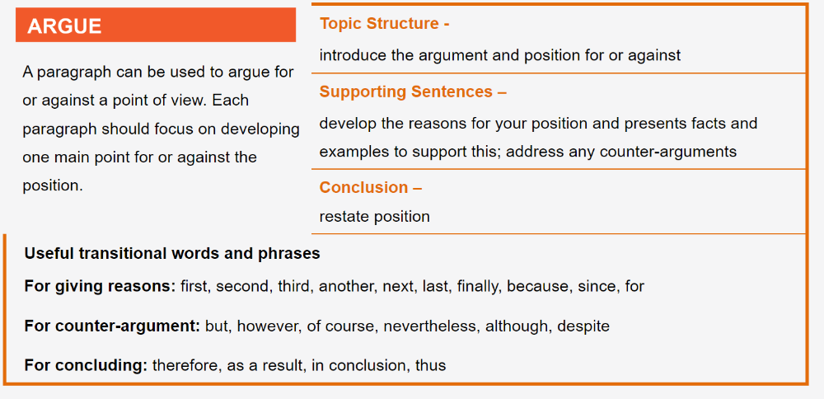
Argument paragraph

Slide 56
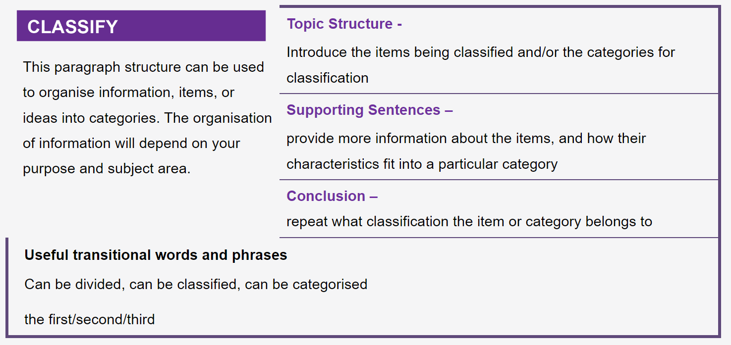
Classification paragraph

Slide 57
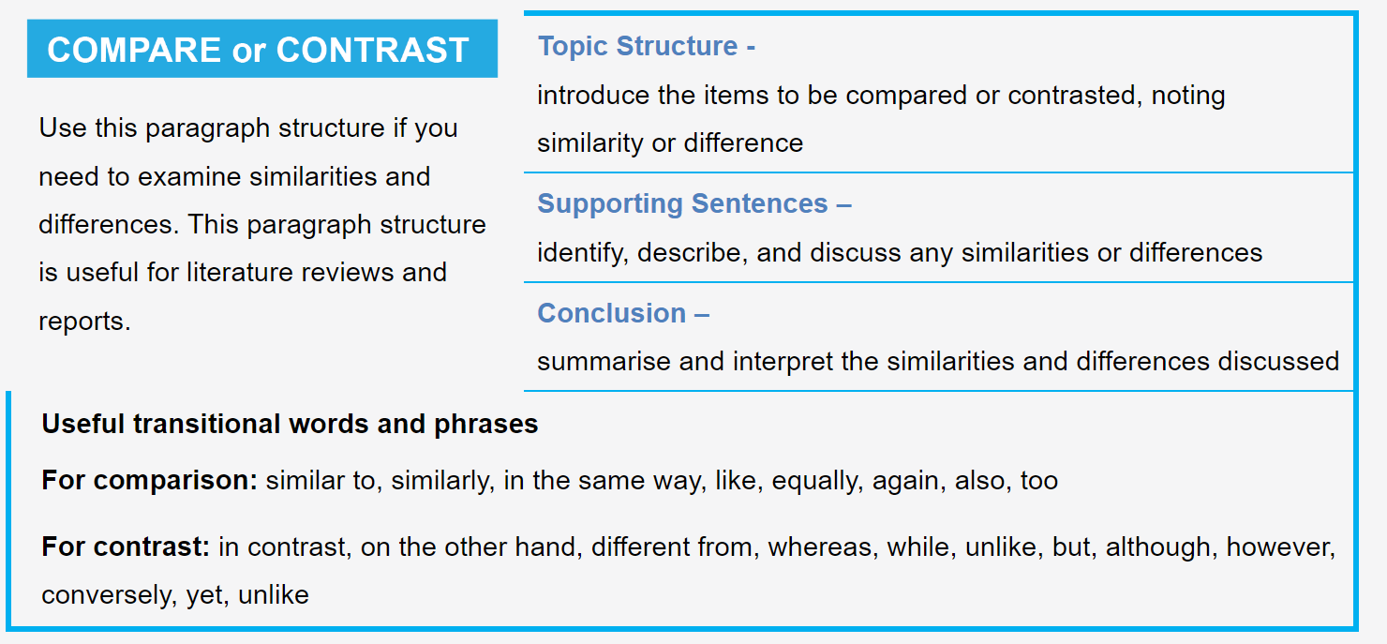
Compare or contrast paragraph

Slide 58
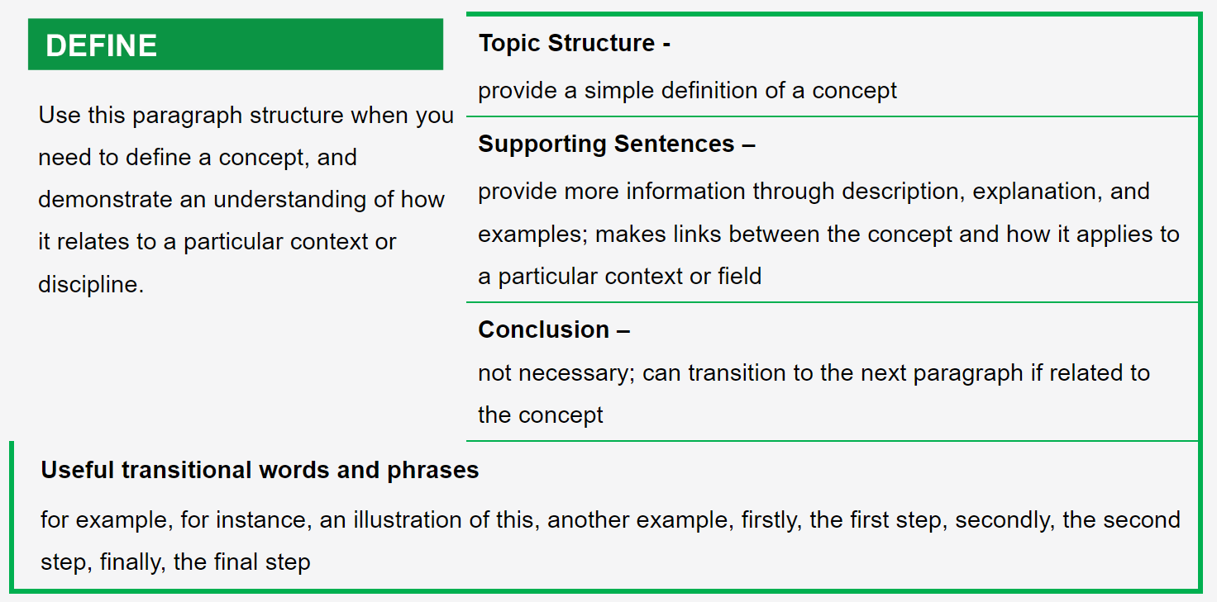
Definition paragraph

Slide 59
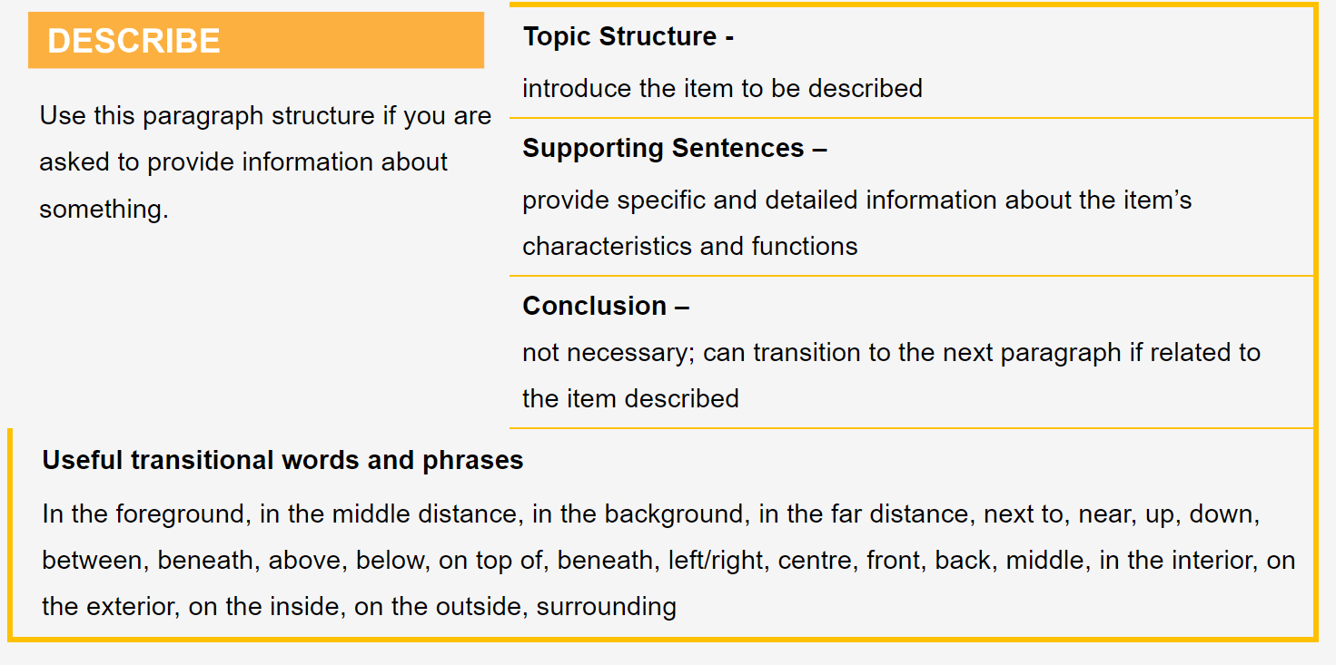
Description paragraph

Slide 60
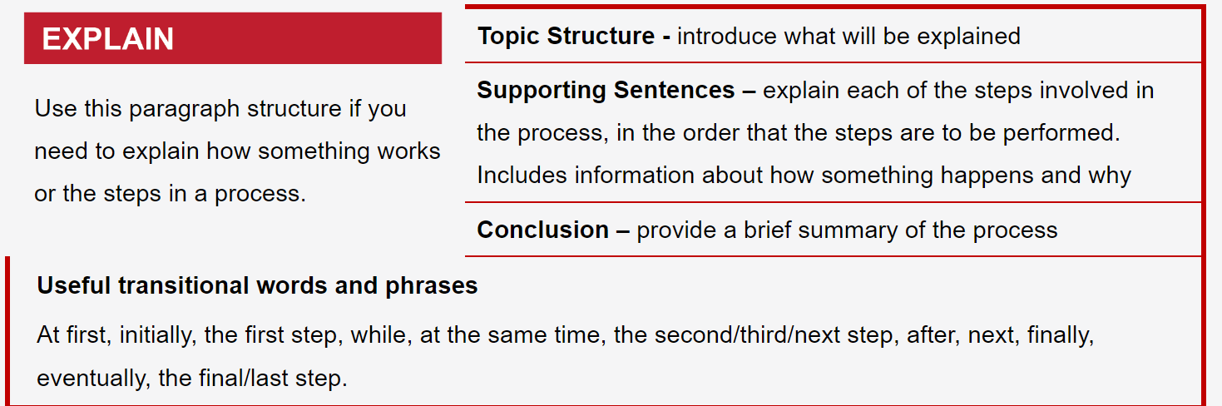
Explanation paragraph

Slide 61
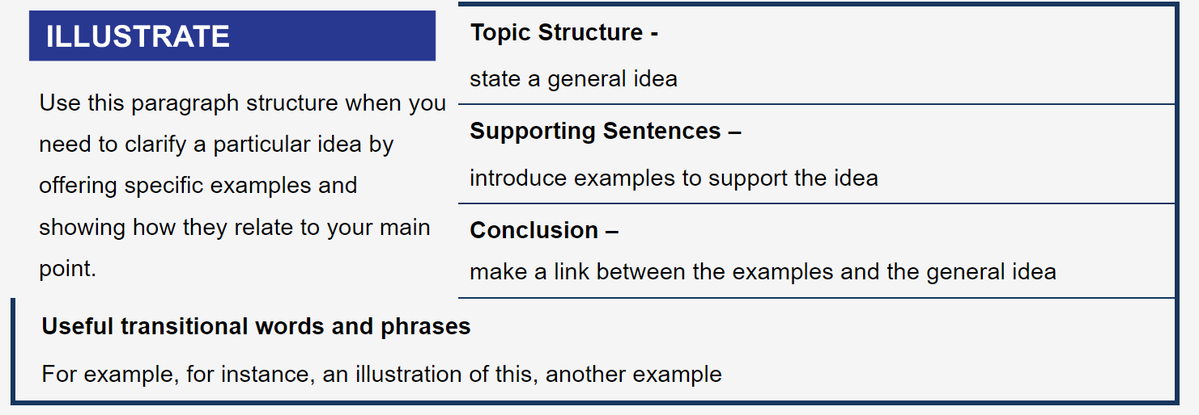
Illustration paragraph

Slide 62
Paragraph writing resources
https://owl.purdue.edu/owl/general_writing/academic_writing/paragraphs_and_paragraphing/index.html
https://writingcenter.unc.edu/tips-and-tools/paragraphs/
https://libguides.newcastle.edu.au/writing-paragraphs/structure
https://www.hunter.cuny.edu/rwc/repository/files/the-writing-process/organization/developing-a-paragraph.pdf
https://www.hunter.cuny.edu/rwc/repository/files/the-writing-process/organization/guidelines-for-paragraphing-updated.pdf
https://www.ncl.ac.uk/academic-skills-kit/writing/academic-writing/paragraphing/

